Slide 1
Data Gathering
SAMIA ARSHAD
Computer Science Department

Slide 2

Data
Data can be numbers, words, measurements, descriptions, comments, photos, sketches, films, videos, or almost anything that is useful for understanding a particular design, user needs, and user behavior.
Data can be quantitative or qualitative.

Slide 3

Key Issues - Setting Goals
It is important to set specific goals for the study. These goals will influence the nature of
data gathering sessions
the data gathering techniques to be used, and the analysis to be performed
Goals should be clear and concise.

Slide 4
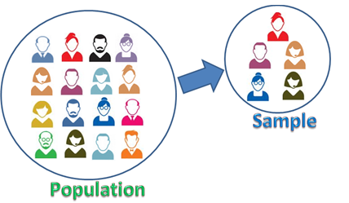
Sampling
Sampling: If participants to be included in data gathering need to be
chosen, and this is called sampling.
In general, having more participants is better because interpretations of statistical test results can be stated with higher confidence.
Most common size being 12.

Slide 5
Key Issues - Identifying Participants
Population:Types of people from whom data is to be gathered.
Sampling: The participants to be included in data gathering need to be chosen.
Saturation sampling: Situation where all members of the target population are accessible is called.
Random sampling:choosing every nth person in a list.

Slide 6
Stratified sampling
divide the population into groups and then applying random sampling.
convenience sampling: Sample includes those who were available rather than those specifically selected.
snowball sampling: Current participant finds another participant and so on.

Slide 7
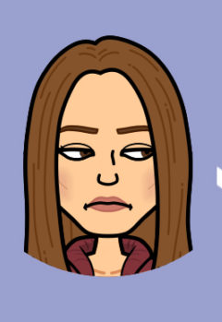
Key Issues - Relationship with Participants
Consent
Personal Details
Special cases (people with disabilities and children)
Ethical considerations
Incentives

Slide 8
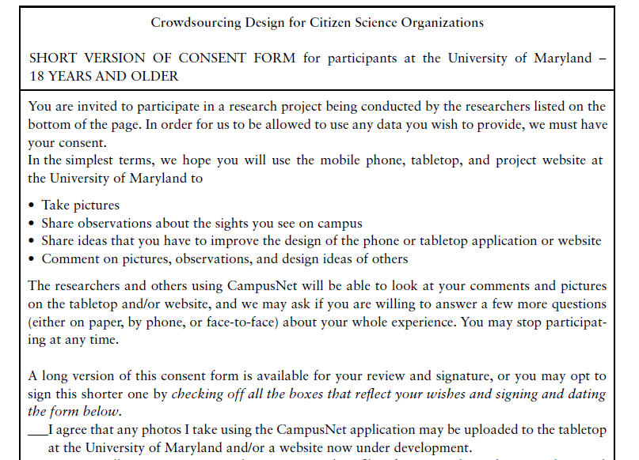
Sample Consent Form

Slide 9
Key Issues - Triangulations
Triangulation is a term used to refer to the investigation of a phenomenon from (at least) two different perspectives.
.

Slide 10
Types:
Triangulation of data: data is drawn from different sources at different times, in different places, or from different people.
Investigator triangulation: different researchers (observers, interviewers, and so on) have been involved in collecting and interpreting the data.
Triangulation of theories: use of different theoretical frameworks through which to view the data or findings.
Methodological triangulation: To employ different data gathering techniques

Slide 11
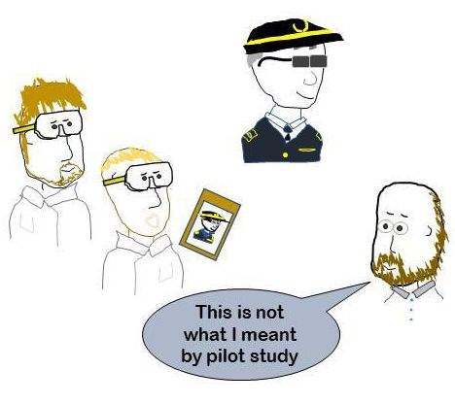
Key Issues - Pilot Study
A pilot study is a small trial run of the main study.
The aim is to make sure that the proposed
method is viable before embarking on the real study.
If it is difficult to find participants or access to them is limited, asking colleagues or peers to participate can work as an alternative for a pilot study.

Slide 12
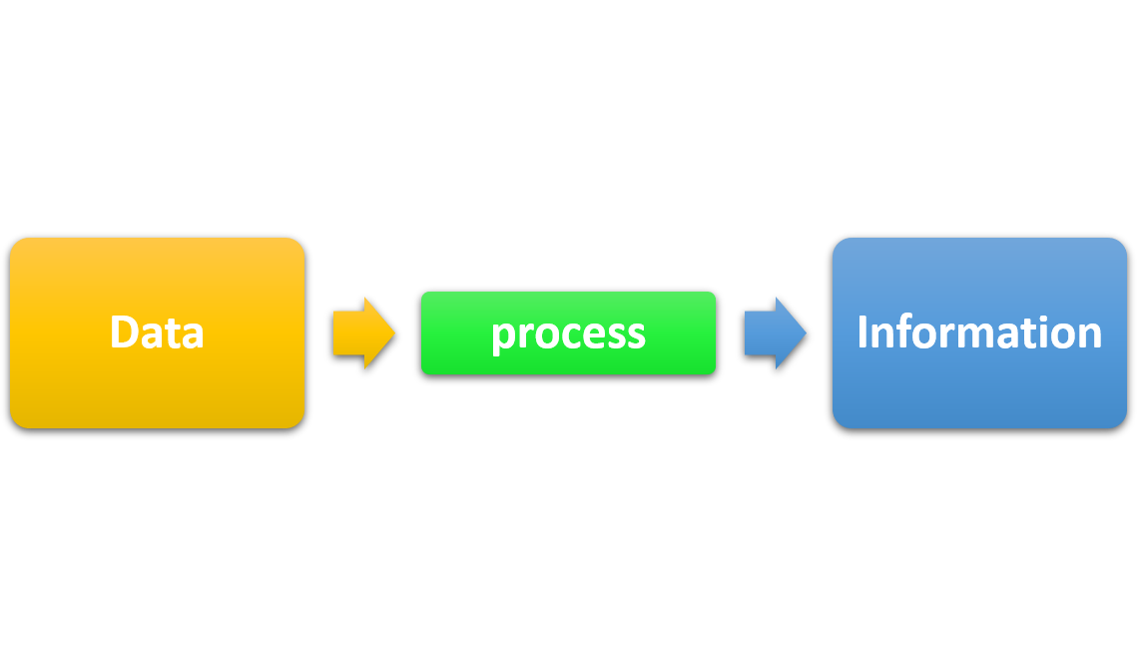
Data , Information & Conclusion
There is an important difference between raw data, information, and conclusions.
Data is what you collect; this is then analyzed and interpreted, and conclusions drawn.
Information is gained from analyzing and interpreting the data and conclusions represent the actions to be taken based on the information.

Slide 13

Data Recording
Some forms of data gathering, such as questionnaires, diaries, interaction logging, scraping, and collecting work artifacts, are self-documenting and no further recording is necessary
The most common recording options are taking notes, photographs, or recording audio or video.

Slide 14
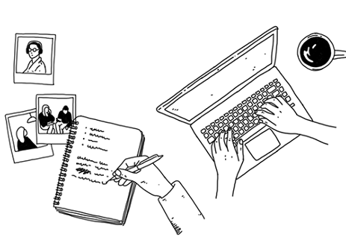
Notes & Photographs
Taking notes (by hand or by typing) is the least technical and most flexible way of recording data, even if it seems old-fashioned.
Handwritten notes may be transcribed in whole or in part.
It gives the analyst a good overview of the quality and contents of the data collected.

Slide 15
Disadvantages
it can be difficult to capture the right highlights
it can be tiring to write and listen or observe at the same time.
it is easy to lose concentration
biases creep in
handwriting can be difficult to decipher
And the speed of writing is limited.
Working with a colleague can reduce some of these problems while also providing another perspective.

Slide 16

Audios plus Photographs
Audio recording is a useful alternative to note-taking and is less intrusive than video.
It isn’t always necessary to transcribe all of the data collected—often only sections are needed, depending on the goals of the study.
Audio recordings are often supplemented with photographs.

Slide 17

Video
Deciding whether to fix the camera’s position or use a roving recorder.
Deciding where to point the camera in order to capture what is required.
Understanding the impact of the recording on participants.

Slide 18
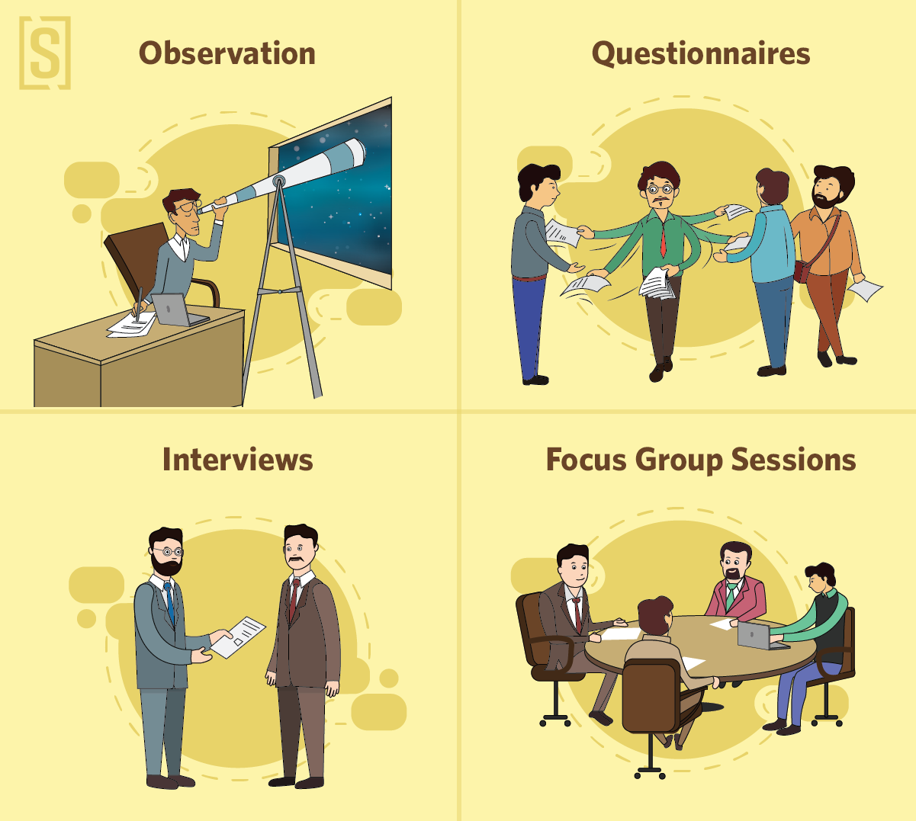
Data Recording Methods

Slide 19

Interviews
Interviews can be thought of as a “conversation with a purpose”
open-ended or unstructured
structured
semi-structured
group interviews
The most appropriate approach to interviewing depends on the purpose of the interview, the questions to be addressed, and the interaction design activity.

Slide 20
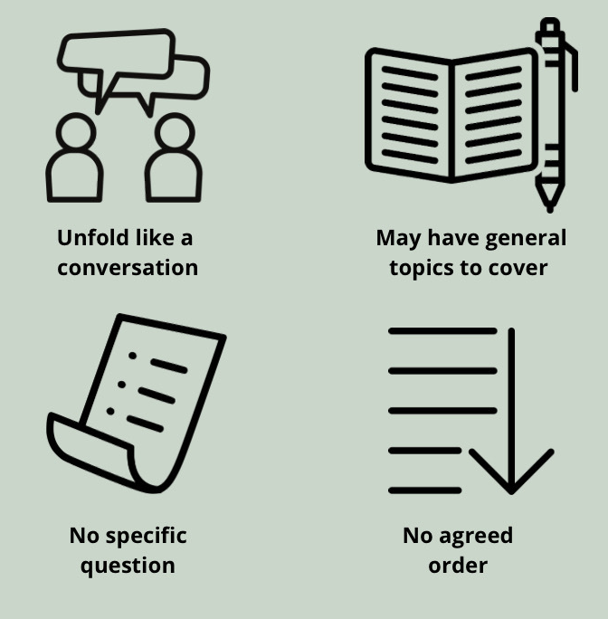
Unstructured Interviews
The interviewer are open, meaning that there is no particular expectation about the format or content of answers.

Slide 21
Unstructured Interview
Interviewer needs a plan of the main topics to be covered
Require probing
Get balance right between obtaining answers to relevant questions and being prepared to follow unanticipated lines of inquiry
Unstructured interviews can be time-consuming to analyze, but they can also produce rich insights.

Slide 22
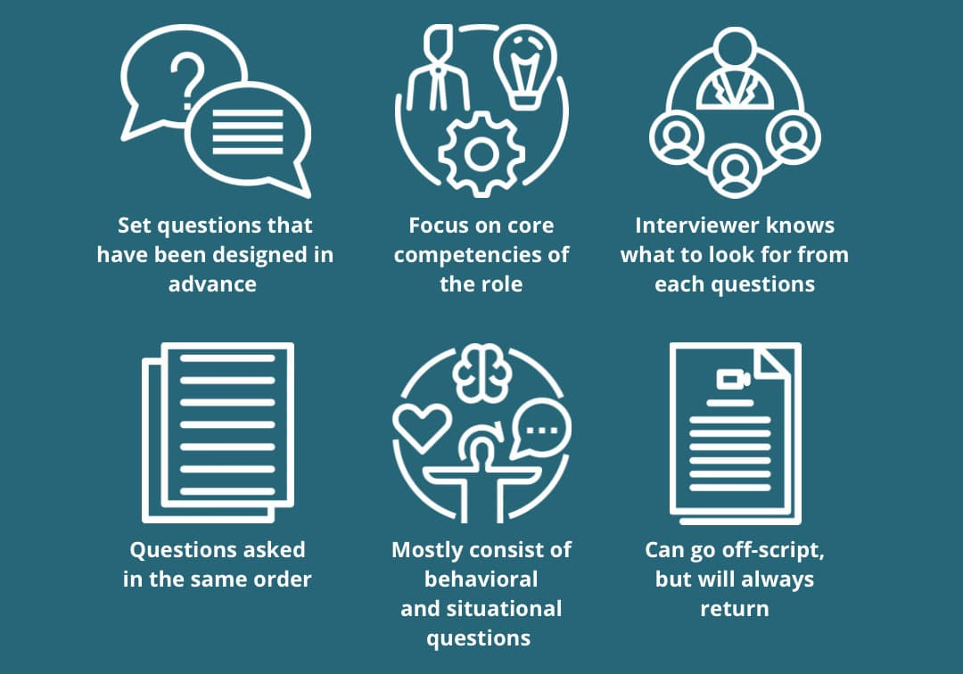
Structured Interviews
In structured interviews, the interviewer asks predetermined questions similar to those in a questionnaire

Slide 23
Structured Interviews
Same questions are used with each participant so that the study is standardized
Questions need to be short and clearly worded, and they are typically closed questions
Questions need to be short and clearly worded, and they are typically closed questions
Structured interview are worded the same for each participant and are asked in the same order
Structured interviews are useful only when the goals are clearly understood and specific questions can be identified.

Slide 24
Semi-Structure Interviews
Semi-structured interviews combine features of structured and unstructured interviews and use both closed and open questions.
Interviewer starts with preplanned questions
probes the interviewee to say more until no new relevant information is forthcoming

Slide 25
Avoid Biasness
Do not pre-empt an answer by phrasing a question to suggest that a particular answer is expected.
body language of the interviewer
Semi-structured interviews are intended to be broadly replicable, so probing and prompting aim to move the interview along without introducing bias.

Slide 26
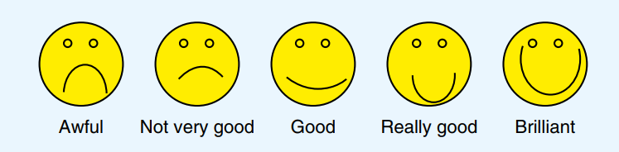
Working with Different Kind of Users
Users vary considerably based on their
Age
educational, life
cultural experiences
physical and cognitive abilities.

Slide 27

Focus Groups
Normally, three to ten people are involved, and the discussion is led by a trained facilitator.
it allows diverse or sensitive issues to be raised
understand multiple points
collaborative process or different user stories
shared issues rather than individual experiences.

Slide 28

Planning and Conducting an Interview
Planning an interview involves
developing the set of questions or topics to be covered
collating any documentation to give to the interviewee (such as consent form or project description)
checking that recording equipment works
structuring the interview
organizing a suitable time and place.

Slide 29
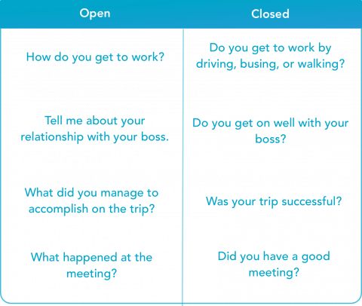
Developing Interview Questions
Questions may be open-ended/closed-ended or a semi-structured interview may use a combination of both types.

Slide 30
Guidelines
Clear and concise questions.
Long or compound questions can be difficult to remember or confusing, so split them into two separate questions.
Example
How do you like this smartphone app compared with previous ones that you have used?”
“How do you like this smartphone app?”
“Have you used other smartphone apps?”

Slide 31
Guidelines
Explain things to them in straightforward ways and keep questions neutral.
Example
“Why do you like this style of interaction?”

Slide 32
Examples
Have you used a device for reading books online before? (Explore previous knowledge.)
□ Yes □ No □ Don’t remember/know
Would you like to read a book using a device designed for reading online? (Explore initial reaction; then explore the response.)
□ Yes □ No □ Don’t know

Slide 33
Examples
Why? If response is “Yes” or “No,” interviewer asks, “Which of the following statements represents your feelings best?”
For “Yes,”
⬜I don’t like carrying heavy books.
⬜This is fun/cool.
⬜My friend told me they are great.
⬜It’s the way of the future.
⬜Another reason (interviewer notes the reason).
For “No,”
⬜I don’t like using gadgets if I can avoid it.
⬜I can’t read the screen clearly.
⬜I prefer the feel of paper.
⬜Another reason (interviewer notes the reason)

Slide 34

Running an Interview
Introduction
Warm up Session
Main Session
Cooling off Period
Closing Session

Slide 35

Remote Interview and Focus Group
The participants are in their own environment and are more relaxed.
Participants don’t have to travel.
Participants don’t need to worry about what they wear.
For interviews involving sensitive issues, interviewees can remain anonymous.
Participants can leave the conversation
Participants can be reached easily,

Slide 36
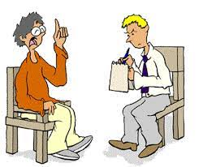
Retrospective Interviews
Interviews that reflect on an activity or a data gathering session done in the recent past.
This is a common practice in observational studies where it is sometimes referred to as member checking.

Slide 37
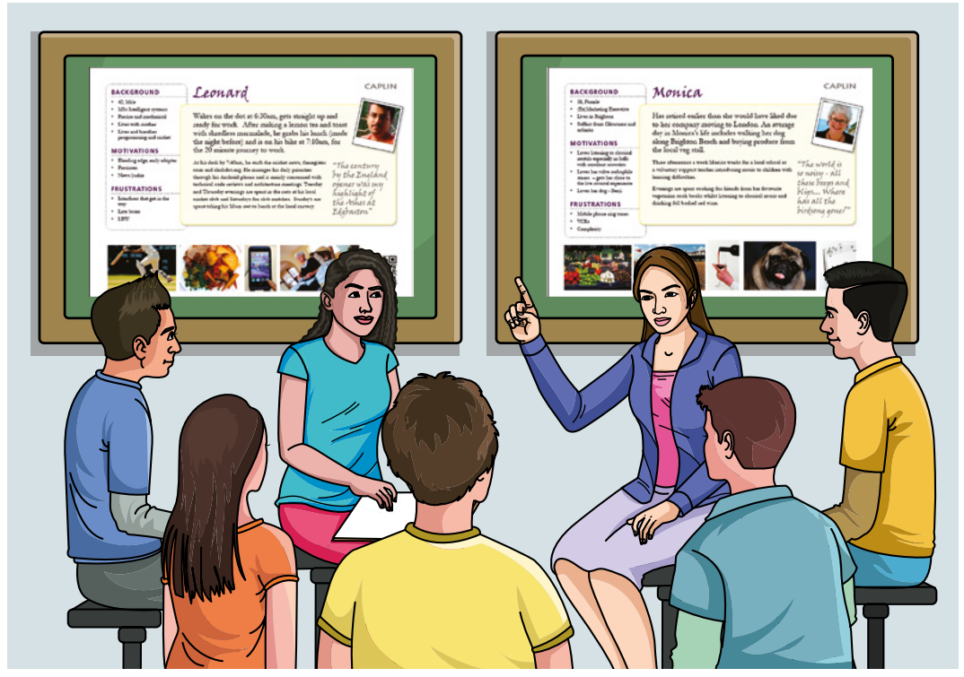
Enriching the Interview Experience
Interviews can be enriched by using props such as personas prototypes or work artifacts.

Slide 38
Questionnaires
Questionnaires are a well-established technique for collecting demographic data and users’ opinions.
Can be close and open ended.
Can be distributed to a large number of participants.
More data can be collected
Remote participants can be involved

Slide 39

Questionnaire or Structured Interview?
Difference lies in the motivation of the respondent to answer the questions.

Slide 40
Questionnaire Structure
Background Information
Demographics
Experience
Contextual Information
Relevant to the study goals

Slide 41

Checklist for Questionnaire
Ordering of question
Consider if different version of questions is required
Provide clear instruction
Length of questionnaires
Allow dropouts
Questionnaire layout and spacing

Slide 42
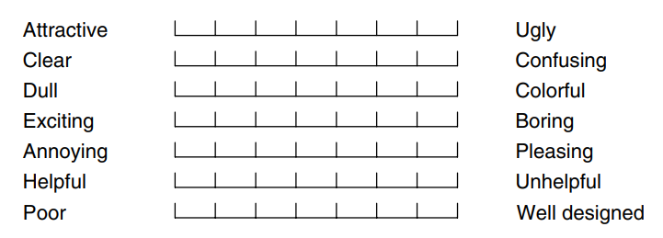
Question and Response Format
Check boxes and ranges
Rating scale
Likert scale
Semantic differential scale

Slide 43
Administrating Questions
Two important issues when using questionnaires are
reaching a representative sample of participants and
ensuring a reasonable response rate.
There can be
Paper questionnaire
Online questionnaire

Slide 44
Deploying Questionnaire
Plan the survey timeline
Design the questionnaire offline.
Program the online survey
Test the survey
Recruit respondents.

Slide 45
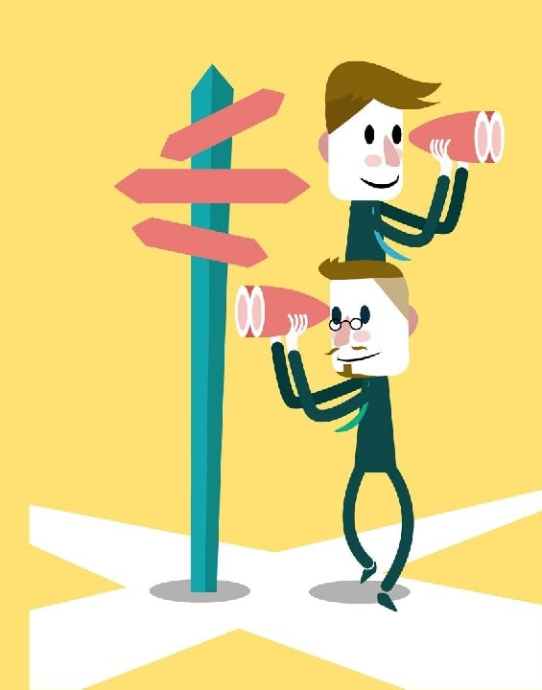
Observation
Observation is useful at any stage during product development.
Early – helps designer understand the users’ context, tasks, and goals
Later – investigates how well a prototype support these task and goals
May be in field or controlled environment.

Slide 46

Direct Observation in the Field
Observation in the field can help fill in details about how users behave and use technology, and nuances that are not elicited from other forms of investigation may be observed.
It explain what they do or to describe accurately how they achieve a task
In a context, why activities happen the way that they do
During an observation, events can be complex and rapidly changing.

Slide 47
Noun Framework for observation
The person: Who is using the technology at any particular time?
The place: Where are they using it?
The thing: What are they doing with it?

Slide 48
Context Framework of Observation
Space: What is the physical space like, and how is it laid out?
Actors: What are the names and relevant details of the people involved?
Activities: What are the actors doing, and why?
Objects: What physical objects are present, such as furniture?
Acts: What are specific individual actions?
Events: Is what you observe part of a special event?
Time: What is the sequence of events?
Goals: What are the actors trying to accomplish?
Feelings: What is the mood of the group and of individuals?

Slide 49
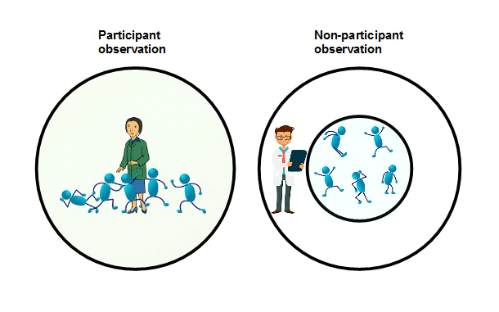
Degree of Participation
Depending on the type of study, the degree of participation within the study environment varies across a spectrum.
An observer who adopts an approach right at the outsider end of the spectrum is called a passive observer
An observer who adopts an approach at the insider end of this spectrum is called a participant observer.

Slide 50
Planning and Conducting an Observation in the field
Things to consider
The level of participation to adopt
How to make a record of the data
How to gain acceptance in the group being studied
How to handle sensitive issues such as cultural differences
How to ensure study uses different perspective.

Slide 51
Ethnography
Ethnographic studies aim to understand what people do and how they organize action and interaction within a particular context of interest to designers.
A situation is observed without imposing any a priori structure or framework upon it, and everything is viewed as “strange.”
The aim is to capture and articulate the participants’ perspective of the situation under study
Ethnographic data is based on what is available, what is “ordinary,” what it is that people do, say, and how they work

Slide 52
Example of Data Collected in Ethnographical Studies
Activity or job descriptions
Rules and procedures (and so on) that govern particular activities
Descriptions of activities observed
Recordings of the talk taking place between parties involved in observed activities
Informal interviews with participants explaining the detail of observed activities
Diagrams of the physical layout, including the position of artifacts
Photographs of artifacts (documents, diagrams, forms, computers, and so on) used in the course of observed activities
Videos of artifacts as used in the course of observed activities
Descriptions of artifacts used in the course of observed activities
Workflow diagrams showing the sequential order of tasks involved in observed activities
Process maps showing connections between activities

Slide 53
Direct Observations in Controlled Environment
Observing users in a controlled environment may occur within a purposely built usability lab.
prepare a script to guide how the participants will be greeted
Tell about the goals of the study and how long it will last
Explain their rights
Ensure that each participant will be treated in same way (scripts)
arrangement of equipment should be proper

Slide 54
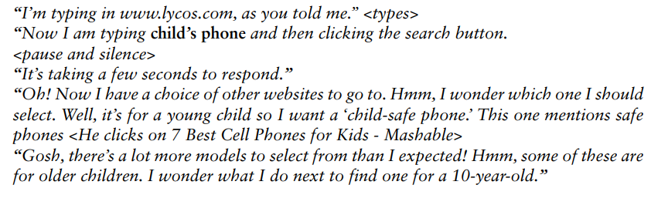
Think Aloud Technique
The think-aloud technique is a useful way of understanding what is going on in a person’s head.
The technique requires people to say out loud everything that they are thinking and trying to do so that their thought processes are externalized
Example:

Slide 55
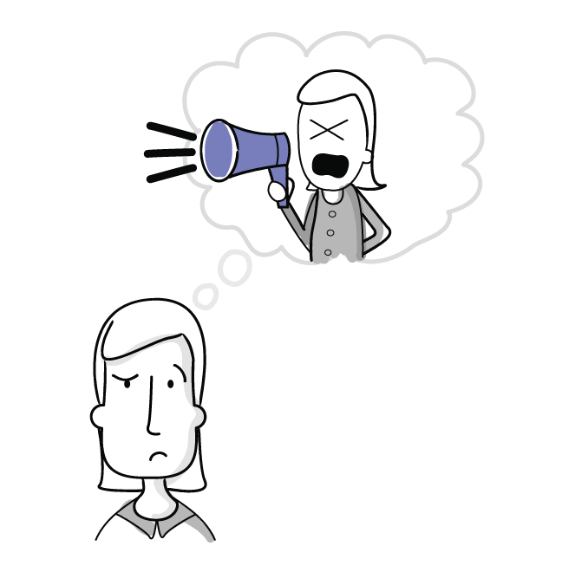
Pros and Cons
Pros
Easy to do
No cost at all
Can identify issues at hands
Cons
Occurrence of silence
Self conscious and awkwardness
Forget to speak out loud
Observer needs to interrupt

Slide 56
Indirect Observations: Tracking Users’ Activities
Diaries
Interaction Logs, Web Analytics, and Data Scraping

Slide 57
Diaries
Participants are asked to write a diary of their activities on a regular basis
Useful when
when participants are scattered and unreachable in person
when the activity is private
Experience Sampling Method (ESM)
similar to a diary such that it relies on participants recording information about their everyday activities. However, it differs from more traditional diary studies because participants are prompted at random times via notifications.

Slide 58
Pros and Cons
Pros
they do not take up much researcher time to collect data
they do not require special equipment or expertise
they are suitable for long-term studies
Cons
participants may lose interest and need incentives to continue
participants’ memories of events may be exaggerated or detail is forgotten
important data may be missed

Slide 59
Interaction Logs, Web Analytics, and Data Scraping
Interaction logging uses software to record users’ activity in a log that can be examined late.
Pros
it is unobtrusive provided system performance is not affected
large volumes of data can be logged automatically
Cons
it might raise ethical concerns

Slide 60


Slide 61
Choosing and Combining Techniques
The benefit of using a combination of methods is to provide multiple perspectives.
Choosing which data gathering techniques to use depends on a variety of factors related to the study goals
Factors to consider
The focus of the study
The participants involved
The nature of the technique
Available resources

Slide 62
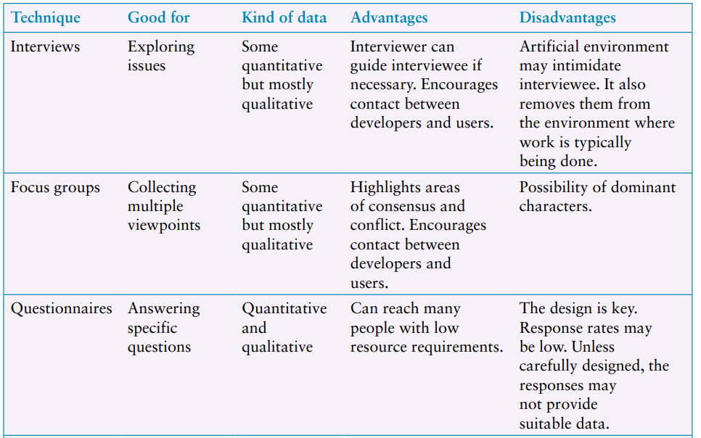
Overview of data gathering techniques and their use

Slide 63
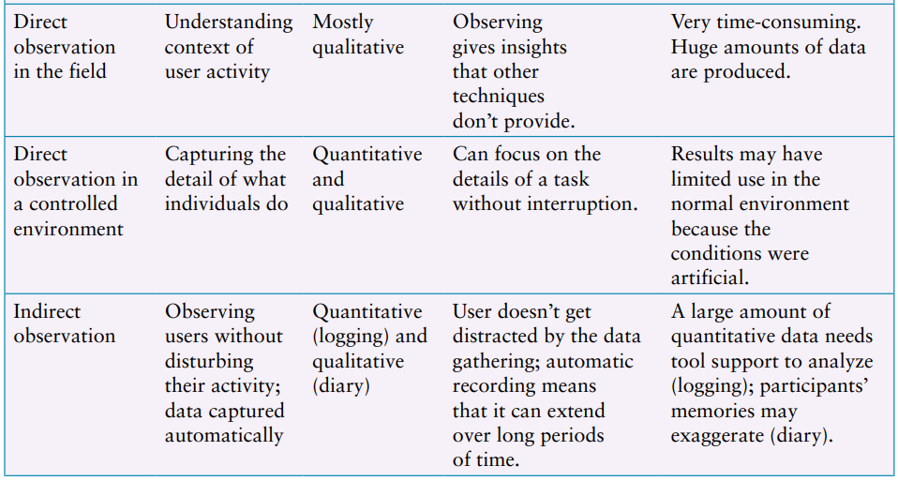
Overview of data gathering techniques and their use

Slide 64
Conclusion
Introduction
Five keys issue
Data recording
Interview
Observations
Questionnaires
Choosing and Combination techniques

